Slide 1
Week 10 Temporal Tables
In-memory Data Files (“memory optimized”)
Temporal “System-Versioned” Tables
Versus
Data Change Capture and Change Tracker

Slide 2
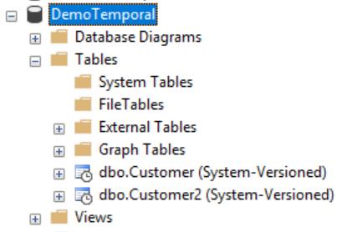
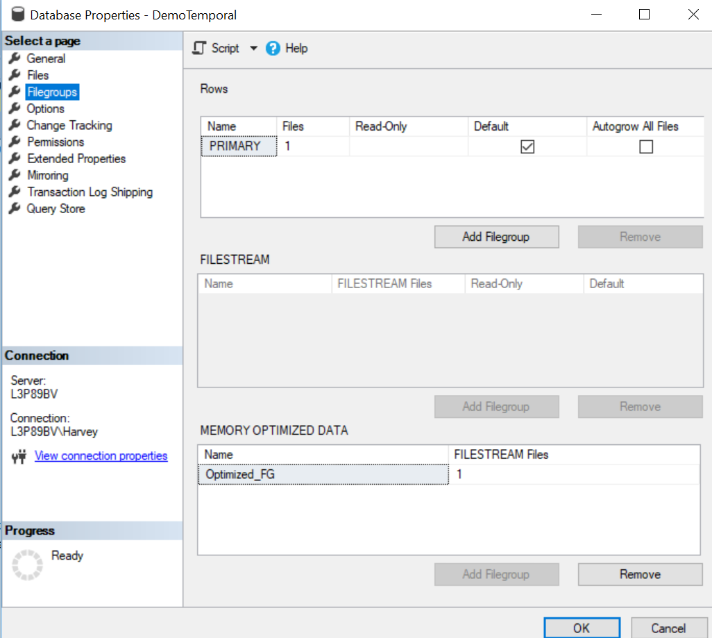
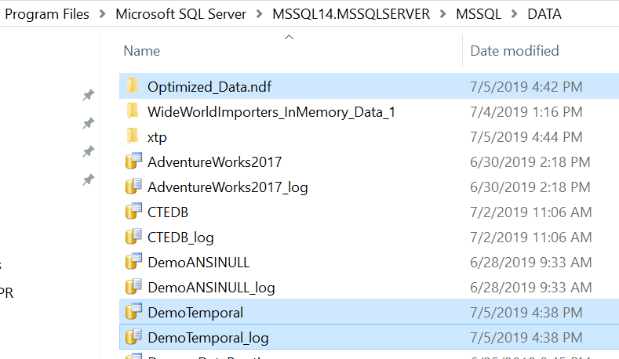

Slide 3
What is a Temporal Table?
“A system-versioned temporal table is a type of user table designed to keep a full history of data changes and allow easy point in time analysis.”
“This type of temporal table is referred to as a system-versioned temporal table because the period of validity for each row is managed by the system.”
“Every temporal table has two explicitly defined columns, each with a datetime2 data type.
These columns are referred to as period columns.
These period columns are used exclusively by the system to record period of validity for each row whenever a row is modified.”
“A temporal table also contains a reference to another table with a mirrored schema.
The system uses this table to automatically store the previous version of the row each time a row in the temporal table gets updated or deleted.
This additional table is referred to as the history table, while the main table that stores current (actual) row versions is referred to as the current table or simply as the temporal table.”
From “theSQLgirl” https://thesqlgirl.com/2018/07/19/temporal-tables/

Slide 4
Practice Reasons to use Temporal Tables:
Auditing all data changes and performing data forensics.
Reconstructing state of the data as of any time in the past.
Calculating trends over time.
Maintaining a slowly changing dimension for decision support applications.
Recovering from accidental data changes and application errors.

Slide 5
What are In-memory data files?
The main benefit of memory-optimized tables are that rows in the table are read from and written to memory which results in non-blocking transactions at super-fast speed.
The second copy of the data is stored on the disk and during database recovery, data is read from the disk-based table.
Memory-optimized tables are for specific types of workloads such as high volume OLTP applications.
** - Temporal tables are often used with an In-memory data file group.

Slide 6
Temporal Tables Set up Links
Explained and Walkthrough Experiment 1:
https://www.mssqltips.com/sqlservertip/5556/benefits-of-using-sql-server-temporal-tables-with-memory-optimized-tables--part-4/
Explained and Walkthrough Experiment 2:
https://www.edwinmsarmiento.com/in-memory-oltp-in-sql-server-logging/

Slide 7
In-Memory Data Files – Memory Optimized Documentation
https://docs.microsoft.com/en-us/sql/relational-databases/in-memory-oltp/the-memory-optimized-filegroup?view=sql-server-2017
https://docs.microsoft.com/en-us/sql/relational-databases/databases/database-files-and-filegroups?view=sql-server-2017

Slide 8
Script for you to practice Temporal Tables experiment:
-- Add memory optimized filegroup and a file
ALTER DATABASE DemoTemporal ADD FILEGROUP [Optimized_FG] CONTAINS MEMORY_OPTIMIZED_DATA
ALTER DATABASE DemoTemporal ADD FILE ( NAME = N'Optimized_Data', FILENAME = N'C:\Program Files\Microsoft SQL Server\MSSQL14.MSSQLSERVER\MSSQL\Data\Optimized_Data.ndf') TO FILEGROUP Optimized_FG
-- Turn memory optimization feature on at the database level
ALTER DATABASE DemoTemporal SET MEMORY_OPTIMIZED_ELEVATE_TO_SNAPSHOT = ON
-- Create a Customer temporal table without Memory optimization
CREATE TABLE Customer
(
CustomerId INT IDENTITY(1,1) PRIMARY KEY, FirstName VARCHAR(30) NOT NULL, LastName VARCHAR(30) NOT NULL,
AmountPurchased DECIMAL NOT NULL, StartDate datetime2 generated always as row START NOT NULL,
EndDate datetime2 generated always as row END NOT NULL, PERIOD FOR SYSTEM_TIME (StartDate, EndDate)
)
WITH(SYSTEM_VERSIONING = ON (HISTORY_TABLE = dbo.CustomerHistory))
--insert 3 rows
INSERT INTO Customer(FirstName, LastName, AmountPurchased)
VALUES ( 'Frank', 'Sinatra',20000.00),( 'Shawn', 'McGuire',30000.00),( 'Amy', 'Carlson',40000.00)
-- create a memory optimized temporal table Customer2
CREATE TABLE Customer2
(
CustomerId INT IDENTITY(1,1), FirstName VARCHAR(30) NOT NULL, LastName VARCHAR(30) NOT NULL,
AmountPurchased DECIMAL NOT NULL, StartDate datetime2 generated always as row START NOT NULL,
EndDate datetime2 generated always as row END NOT NULL, PERIOD FOR SYSTEM_TIME (StartDate, EndDate),
CONSTRAINT PK_CustomerID PRIMARY KEY NONCLUSTERED HASH (CustomerId) WITH (BUCKET_COUNT = 131072)
)
WITH(MEMORY_OPTIMIZED = ON, DURABILITY = SCHEMA_AND_DATA,
SYSTEM_VERSIONING = ON (HISTORY_TABLE = dbo.Customer2History))
--insert the same 3 rows
INSERT INTO dbo.Customer2 ( FirstName, LastName, AmountPurchased)
VALUES ( 'Frank', 'Sinatra',20000.00),( 'Shawn', 'McGuire',30000.00),( 'Amy', 'Carlson',40000.00)
-- select data from both tables with Execution plan and Live Query Statistics on
SELECT * FROM dbo.Customer
SELECT * FROM dbo.Customer2

Slide 9
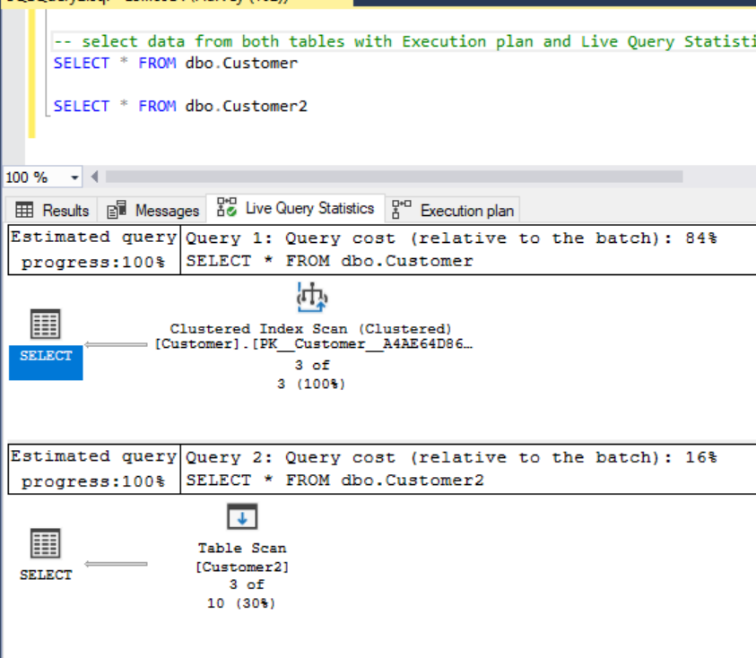
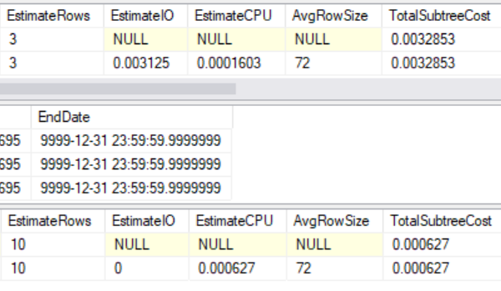
Execution Plan Evaluate Performance

Slide 10
Test Case provided by TheSQLGirl
--create table with system versioning on
CREATE TABLE dbo.Employee
(
EmployeeID int NOT NULL PRIMARY KEY CLUSTERED, Name nvarchar(100) NOT NULL, Position varchar(100) NOT NULL,
Department varchar(100) NOT NULL, Address nvarchar(1024) NOT NULL, AnnualSalary decimal (10,2) NOT NULL,
ValidFrom datetime2 (2) GENERATED ALWAYS AS ROW START,
ValidTo datetime2 (2) GENERATED ALWAYS AS ROW END,
PERIOD FOR SYSTEM_TIME (ValidFrom, ValidTo)
)
WITH (SYSTEM_VERSIONING = ON (HISTORY_TABLE = dbo.EmployeeHistory));
--insert value
INSERT INTO dbo.employee (employeeID, Name, Position, Department, Address, AnnualSalary)
VALUES ( '1000', 'Billy Holiday', 'President', 'Sales', '123 Main Street', '100.00')
--test query
SELECT * FROM Employee
FOR SYSTEM_TIME BETWEEN '2019-01-01 00:00:00.0000000' AND '2019-07-07 00:00:00.0000000'
WHERE EmployeeID = 1000 ORDER BY ValidFrom;

Slide 11
Compare with: Change Data Capture (CDC) vs Change Tracking (CT)
CT keeps track of how many times a change happened in a table since it has been enabled.
Keeps history of previous changes, but stores only the last change made to the row.
Change tracking of the row is tracked based on the primary key column.
Enabled at the database level and then for the specific table you want to track changes.
CDC
Records INSERTs, UPDATEs, and DELETEs applied to SQL Server tables, and makes a record of what changed, where, and when, in ‘change tables.’
Only tracks changes in user-created tables. A mirror of the tracked table is created with the same column structure of the original table. DBA can monitor changes recorded.

Slide 12
CT Walkthrough
https://www.mssqltips.com/sqlservertip/5211/sql-server-temporal-tables-vs-change-data-capture-vs-change-tracking--part-1/
--create table, PK constraint, insert values
CREATE TABLE Customer (CustomerId INT IDENTITY (1,1), FirstName VARCHAR(30), LastName VARCHAR(30) NOT NULL, Amount_purchased DECIMAL)
ALTER TABLE dbo.Customer ADD CONSTRAINT PK_Customer PRIMARY KEY (CustomerId, LastName)
INSERT INTO dbo.Customer ( FirstName, LastName, Amount_Purchased)
VALUES ( 'Frank', 'Sinatra',20000.00),( 'Shawn', 'McGuire',30000.00),( 'Amy', 'Carlson',40000.00)
--Test Query
SELECT * FROM dbo.Customer
-- Enable change Tracking at Database Level
ALTER DATABASE DemoCT
SET CHANGE_TRACKING = ON (CHANGE_RETENTION = 2 DAYS, AUTO_CLEANUP = ON)
-- Enable change Tracking at Table Level
ALTER TABLE dbo.Customer
ENABLE CHANGE_TRACKING WITH (TRACK_COLUMNS_UPDATED = ON)
-- Verify the status of the change tracking with no version history
SELECT CHANGE_TRACKING_CURRENT_VERSION () AS CT_Version
SELECT * FROM CHANGETABLE (CHANGES Customer,0) as CT ORDER BY SYS_CHANGE_VERSION
SELECT c.CustomerId, c.LastName , ct.SYS_CHANGE_VERSION, ct.SYS_CHANGE_CONTEXT
FROM Customer AS c
CROSS APPLY CHANGETABLE (VERSION Customer, (customerId,Lastname), (c.CustomerId,c.LastName)) AS ct;
-- Make changes in table records
-- insert a row
INSERT INTO Customer(FirstName, LastName, Amount_purchased)
VALUES('Ameena', 'Lalani', 50000)
-- delete a row
DELETE FROM dbo.Customer
WHERE CustomerId = 2
-- update a row
UPDATE Customer
SET Lastname = 'Clarkson' WHERE CustomerId = 3
--Rerun change tracking with history

Slide 13
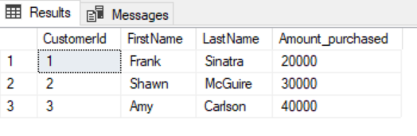
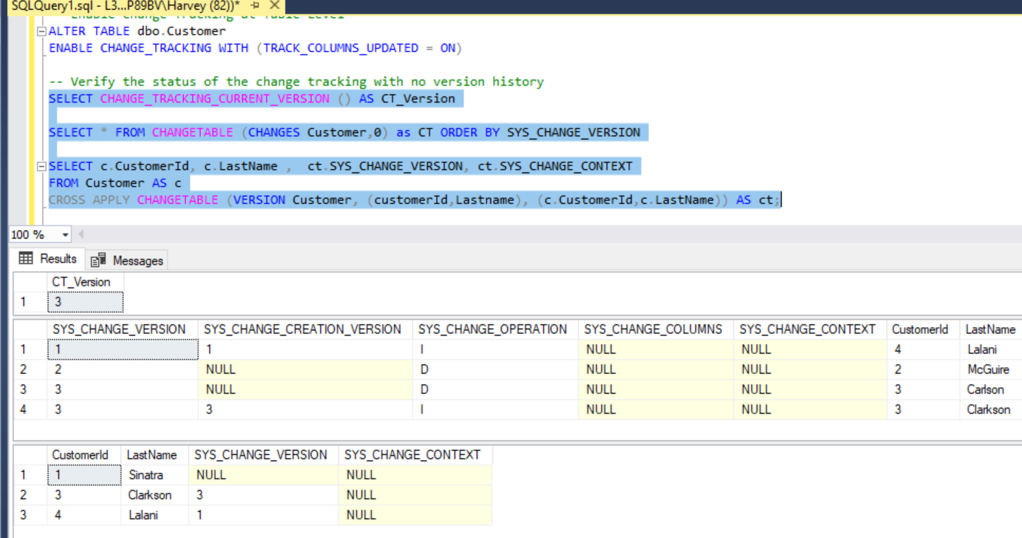
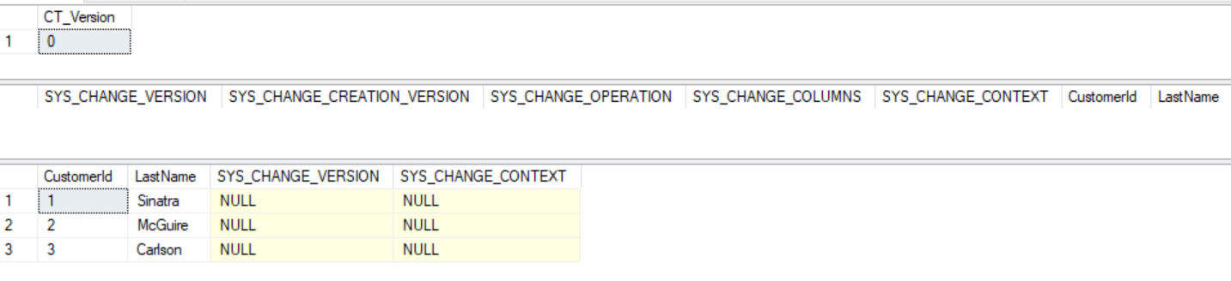
Compare CT Reports

Slide 14
CDC Walkthroughs
Example 1: Customer Table
https://www.mssqltips.com/sqlservertip/5212/sql-server-temporal-tables-vs-change-data-capture-vs-change-tracking--part-2/
Example 2: Adventure Works 2017
https://www.red-gate.com/simple-talk/sql/learn-sql-server/introduction-to-change-data-capture-cdc-in-sql-server-2008/
Example 3: Customer Table
https://www.mssqltips.com/sqlservertip/1474/using-change-data-capture-cdc-in-sql-server-2008/

Slide 15
Invoking a CDC Structure requires:
You need to know how to create functions:
Scalar and Table-Valued
You need to know how to Create Jobs and Start the Job Agent

Slide 16
CDC Elements
Log sequence number
Every record in the SQL Server transaction log is uniquely identified by a log sequence number (LSN).
Begin_LSN
End_LSN
Tracking Changes Functions
Returns one net change row for each source row changed within the specified Log Sequence Numbers (LSN) range.
get_net
get_all
https://docs.microsoft.com/en-us/sql/relational-databases/system-functions/cdc-fn-cdc-get-net-changes-capture-instance-transact-sql?view=sql-server-2017

Slide 17
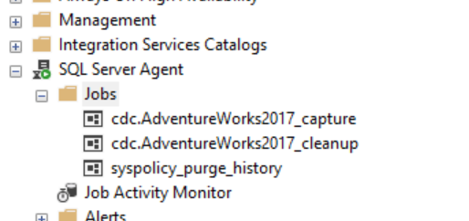
Reviewing Job Agent
Adding Job
Starting Job
Starting Job Agent
exec sys.sp_cdc_add_job @job_type = N'capture';
exec sys.sp_cdc_add_job @job_type = N'cleanup';
EXEC sys.sp_cdc_start_job @job_type = N'capture';
EXEC sys.sp_cdc_start_job @job_type = N'cleanup';

Slide 18
Steps to create a CDC System Table Structure:
Create your DB
Create your table
Enable CDC at the db level
Enable CDC at the table level
Add jobs, start jobs, restart if needed
Add rows to table
Insert, update, and delete rows
Create your functions and any SPROCs you need to call them with
Declare begin_lsn, end_lsn parameters
Select from cdc functions to find record of changes

Slide 19
Syntax of code blocks:
--enable CDC at database level
declare @rc int
exec @rc = sys.sp_cdc_enable_db
select @rc
-- is_cdc_enabled?
select name, is_cdc_enabled from sys.databases
--enable at table level
exec sys.sp_cdc_enable_table
@source_schema = 'dbo',
@source_name = 'customer' ,
@role_name = 'CDCRole',
@supports_net_changes = 1
--/
select name, type, type_desc, is_tracked_by_cdc from sys.tables
--/
--/
declare @begin_lsn binary(10), @end_lsn binary(10)
-- get the first LSN for customer changes
select @begin_lsn = sys.fn_cdc_get_min_lsn('dbo_customer')
-- get the last LSN for customer changes
select @end_lsn = sys.fn_cdc_get_max_lsn()
-- get net changes; group changes in the range by the pk
select * from cdc.fn_cdc_get_net_changes_dbo_customer(@begin_lsn, @end_lsn,'all');
-- get individual changes in the range
select * from cdc.fn_cdc_get_all_changes_dbo_customer(@begin_lsn, @end_lsn,'all');

Slide 20
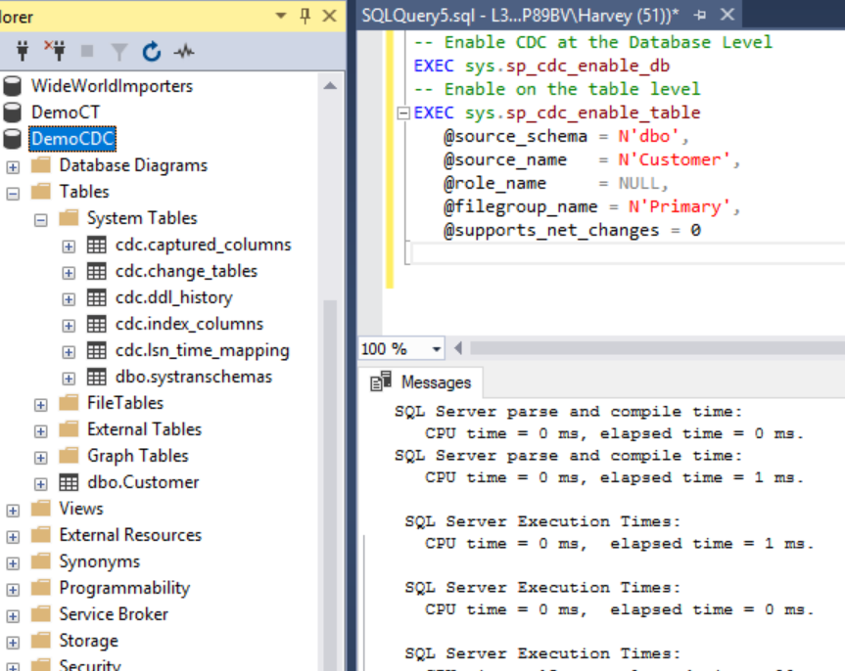
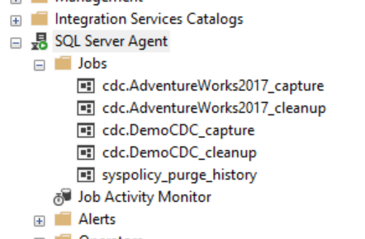
Review CDC system table structure
Make sure job agent is running.
Make sue capture job and clean up job have been created.

Slide 21
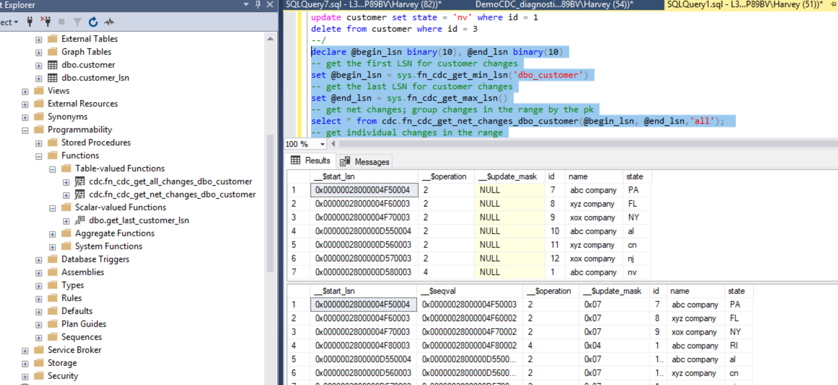
Will look like this if you set everything up correctly:

Slide 22
Temporal Table, CDC, CT Exercise
1. Create temporal tables on your most recent database and run experiment to compare execution plan performance with in-memory and not in-memory optimization.
2. Create CDC structure and Create CT structure
3. Run experiment series demonstrating comparisons of Temporal Table performance with Data Capture and Change Tracking.

